Slide 1
Pulse Width Modulation - PWM
IEEEngage
Gantabya

Slide 2
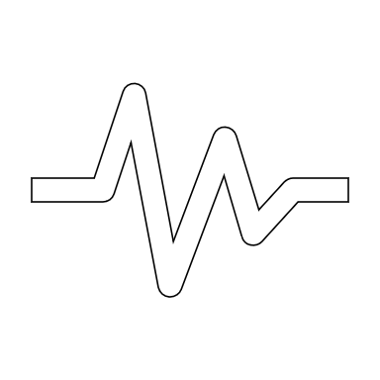
Pulse Width Modulation (PWM)
A term for describing a type of digital signal.
Digital Signals generated/passed in pulse(s)
Used in variety of applications
Common Example:
Brightness/Dimming of Screen Leds etc.
Motor control

Slide 3
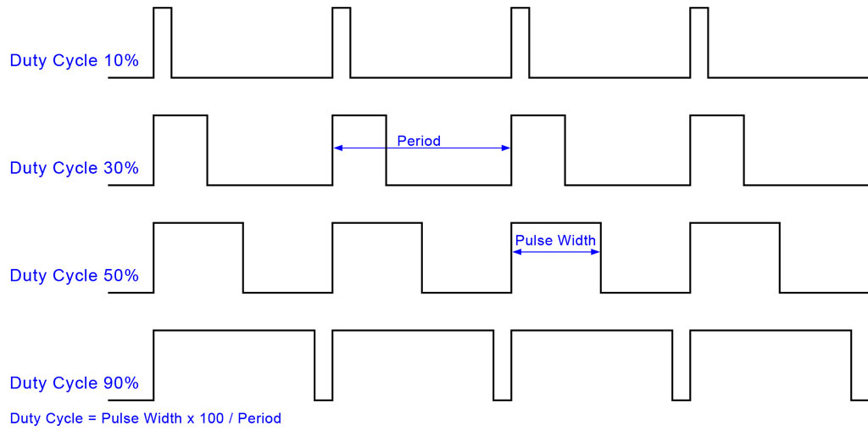
Duty Cycle

Slide 4
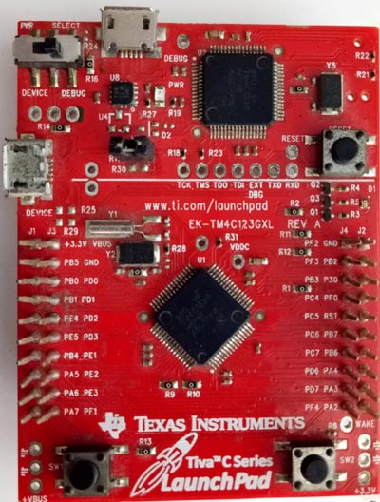
PWM Module on Tiva C
2 PWM modules
MnPWM
Each Module has 4 PWM generator blocks and a control block
PWM0 – PWM3
Total of 16 PWM Outputs.
PWM generators can operate independently
Generators may be synchronized together as well.
Recommend Reading Datasheet (pg 1230)
Check resources folder in the github repo.

Slide 5
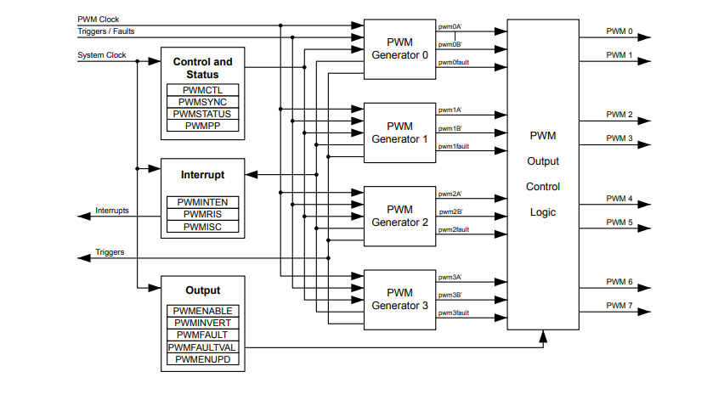
PWM Module Diagram

Slide 6
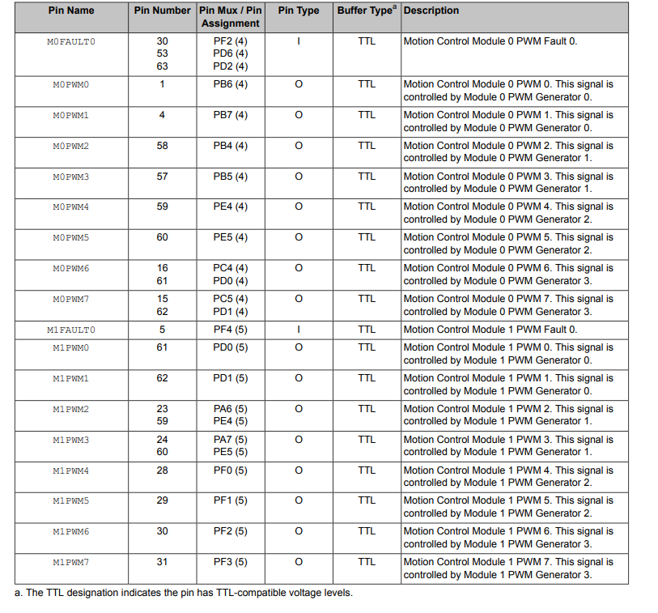
PWM Signals
We’ll be utilizing Pin #s 29-31
Respective Pin Name(s):
M1PWM5 – M1PWM7
Corresponding pins on board: PF1 – PF3
On Board LED Pings. PF1 = Red, PF2 = Green, PF3 = Blue
All this info available on the datasheet.

Slide 7

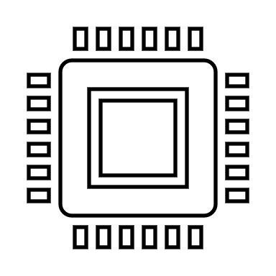
DEMO TIME

